Slide 1
MEDICINE REVIEW AND ITS SIDE EFFECT ANLAYSIS Mentor: Sri Vinod
TEAM MEMBER:
1.SAGAR
2.MANJUNATH
3.DINESH RAWAT
4.BASAVAKIRAN
5.PRAVEEN
6.PRATEK

Slide 2
BUSINESS PROBLEM
Current growing market in pharmaceutical's industries is provide a new growth to medical science which in favor providing us the huge options in medicines to cure a single disease. Our Idea is to create a product that could be helpful for companies like 1mg to provide detailed rating of the side effects of the product over their site. It could also be helpful for the patients who are buying drugs online to check the side effects of the drugs before buying it.

Slide 3
Project Architecture / Project Flow
Web scrapping and
Data Collection
Exploratory Data Analysis
Data Preprocessing
Model Selection
Deployment

Slide 4
DATA SET DETAILS :
The dataset provides patient reviews on specific drugs along with related conditions and rating out of 10 reflecting overall patient satisfaction. The intention was to study sentiment analysis of drug experience over multiple facets, i.e. sentiments learned on specific aspects such as condition and reviews on the drug.
The data consists of below details respectively.
drug_dataset.csv :
Shape of Dataset: (215063, 8)
No. of Features: 8
No. of Records : 215063

Slide 5
Attribute Information
Drug name -: drug used by the patient
condition -: Condition of the Patient
review -: Review by the patient
rating -: Patient rating
date -: Date of the drugs Consumption
Useful count -: number of users who found review useful
Side Effect -: Drug side effects
Side Effect Review -: Side Effect Review by the patient

Slide 6
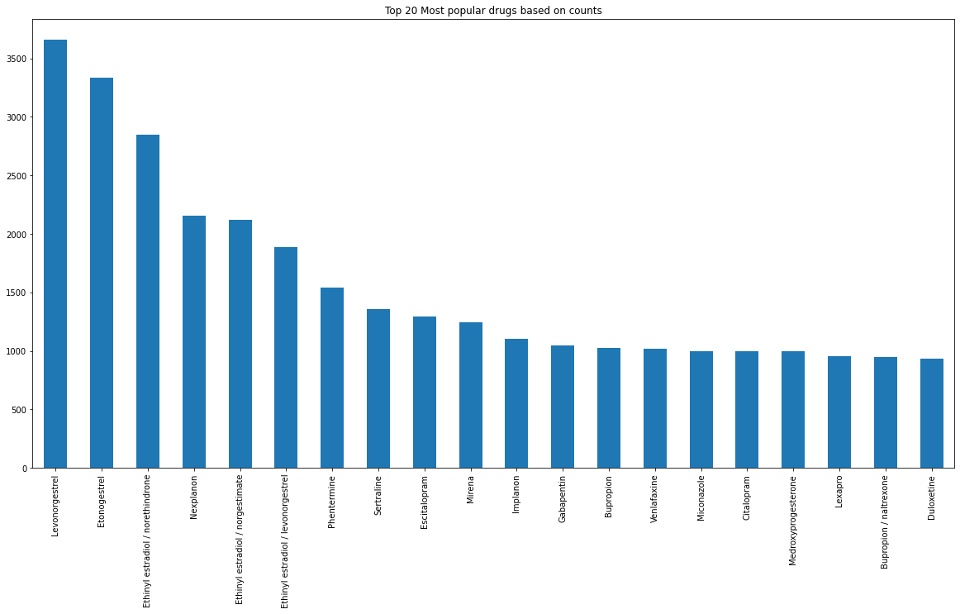
Exploratory data anlaysis
Etonogestrel 3336
Ethinyl estradiol / norethindrone 2850
Nexplanon 2156
Ethinyl estradiol / norgestimate 2117
Ethinyl estradiol / levonorgestrel 1888
Phentermine 1543
Sertraline 1360
Escitalopram 1292
Mirena 1242
Implanon 1102
Gabapentin 1047
Bupropion 1022
Venlafaxine 1016
Miconazole 1000
Citalopram 995
Medroxyprogesterone 995
Lexapro 952
Bupropion / naltrexone 950
Duloxetine 934
Top 20 most popular drugs
INFERENCE
Most of the commonly used drugs are Harmonal drugs

Slide 7
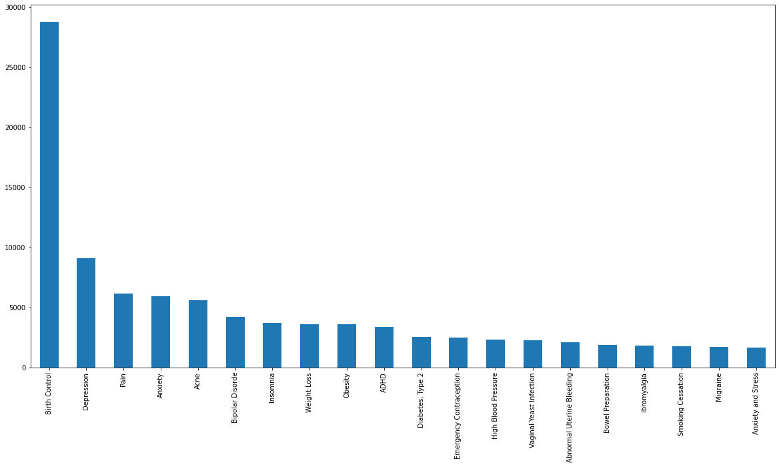
TOP 20 CONDITIONS
Birth Control 28788
Depression 9069
Pain 6145
Anxiety 5904
Acne 5588
Bipolar Disorder 4224
Insomnia 3673
Weight Loss 3609
Obesity 3568
ADHD 3383
Diabetes, Type 2 2554
Emergency Contraception 2463
High Blood Pressure 2321
Vaginal Yeast Infection 2274
Abnormal Uterine Bleeding 2096
Bowel Preparation 1859
Ibromyalgia 1791
Smoking Cessation 1780
Migraine 1694
Anxiety and Stress 1663
The most common condition is Birth Control followed by Depression , Pain and Anxiety.. Which are majorly seen in society

Slide 8
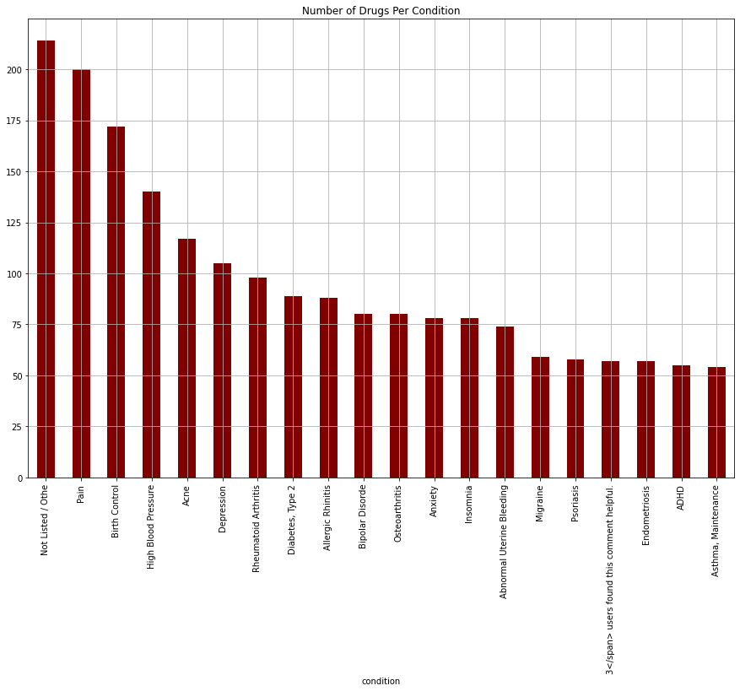
TOP 20 Drugs per condition
Condition –(No. of drugs)
Pain 200
Birth Control 172
High Blood Pressure 140
Acne 117
Depression 105
Rheumatoid Arthritis 98
Diabetes, Type 2 89
Allergic Rhinitis 88
Bipolar Disorder80
Osteoarthritis 80
Anxiety 78
Insomnia 78
Abnormal Uterine Bleeding 74
Migraine 59
Psoriasis 58
Endometriosis 57
ADHD 55
Asthma, Maintenance 54
1.Pain ,Birth Control and HBP have the highest number of different/unique drugs for their condition
2.Implies Companies are majorly concentrated in these drugs manufacturing and research

Slide 9
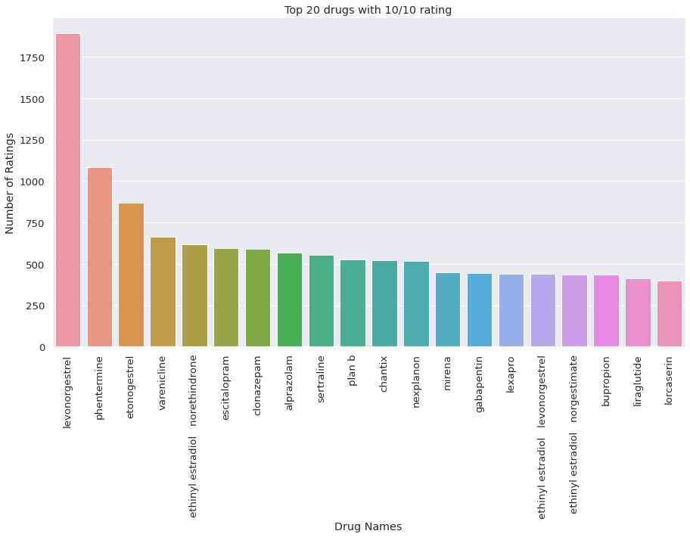

Slide 10
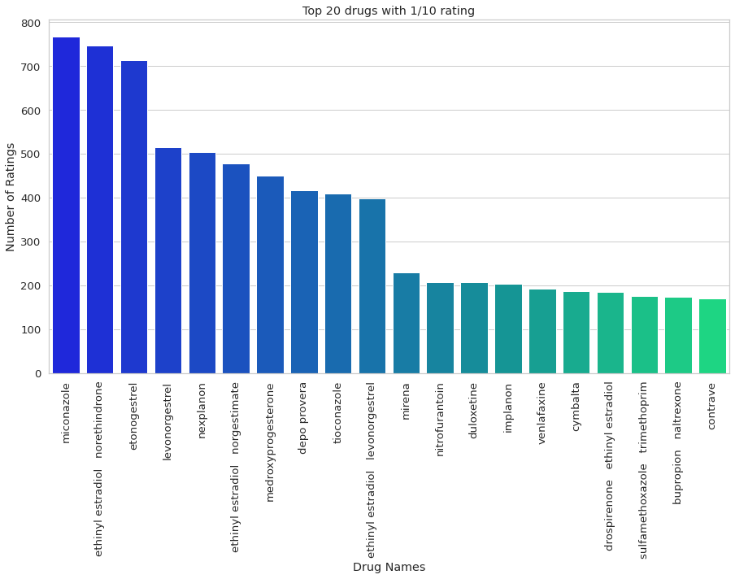

Slide 11
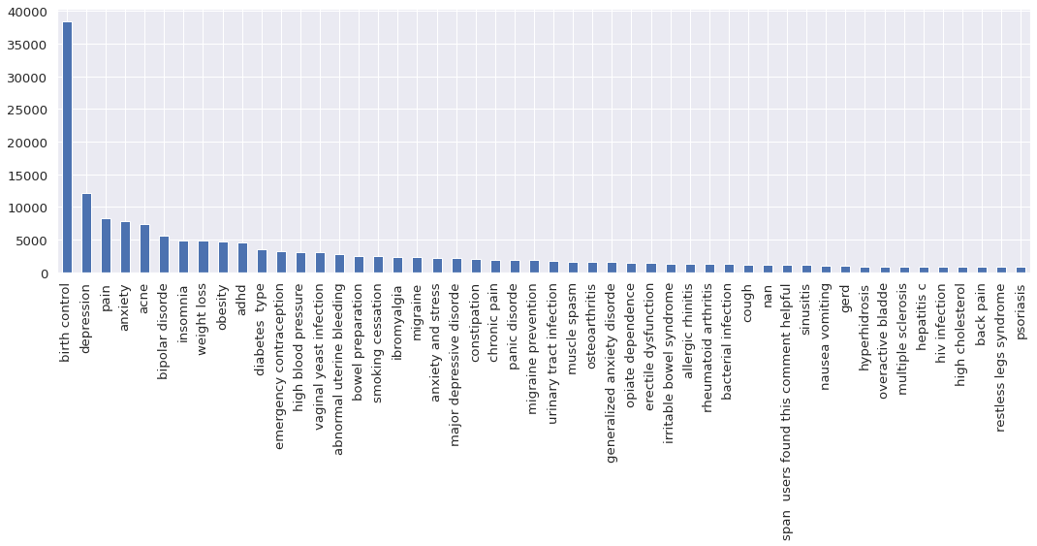
Top 50 most occurring conditions for using drugs by the patients

Slide 12
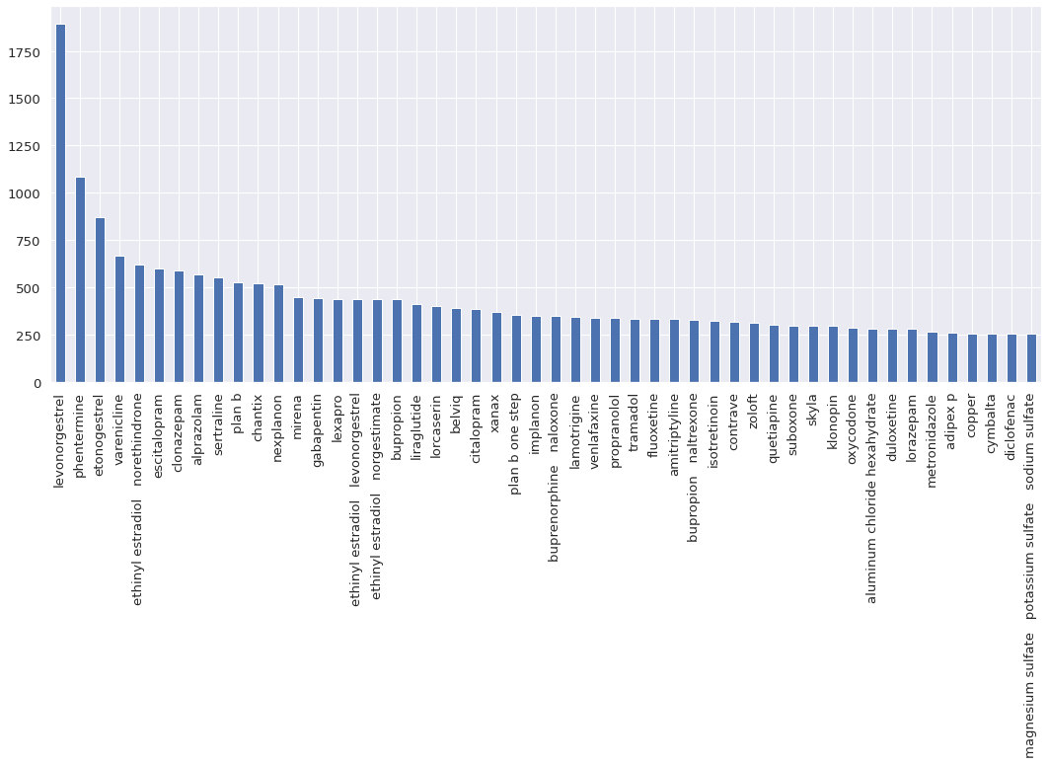
Drug with highest rating

Slide 13
DATA PREPROCESSING
In the data preprocessing we have used blob polarity for sentiment analysis.
And the blob polarity we have taken -0.3 to 0.3
We have done sentiment analysis for drug review and side effect and side effect review.

Slide 14
DATA PREPROCESSING
In the data pre processing we have done 6 main things That is :
1.Deleted html
2.Make a space
3.Lower letters
4.Stop words
5.Lemitization
6.Space join words

Slide 15
SENTIMENT ANLYSIS FOR REVIEW
In the review sentiment analysis there are more neutral reviews.
neutral 179943
positive 24915
negative 10205

Slide 16
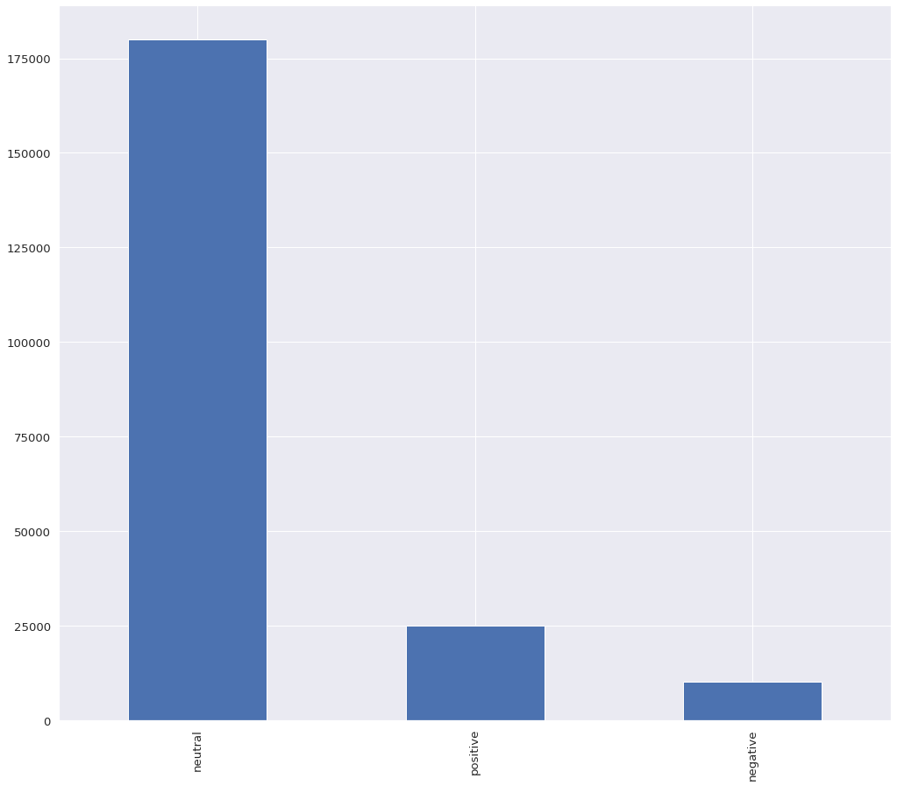

Slide 17
SENTIMENT ANLYSIS FOR SIDE EFFECT
In the sentiment analysis for side effect there are no negative response.
neutral 131844
positive 83219

Slide 18
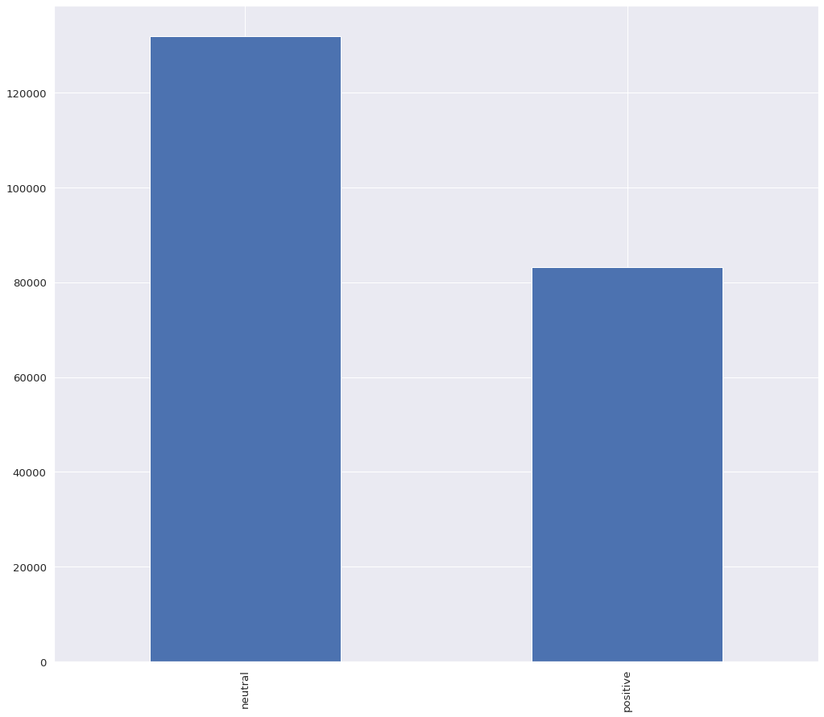

Slide 19
SENTIMENT ANLYSIS FOR SIDE EFFECT REVIEW
In the side effect review also neutral response is high.
neutral 160858
positive 29981
negative 24224

Slide 20
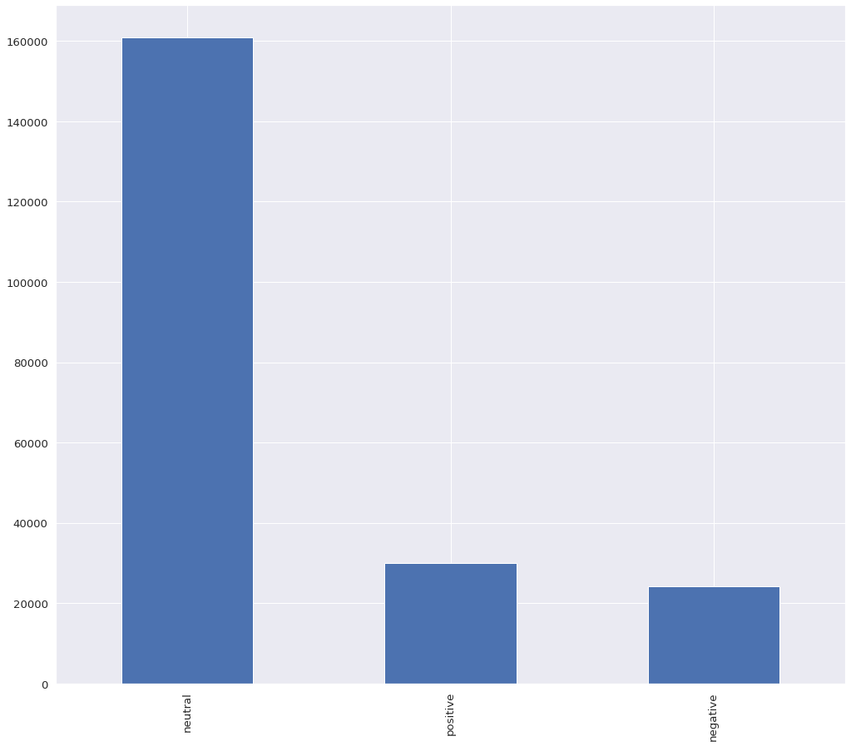

Slide 21
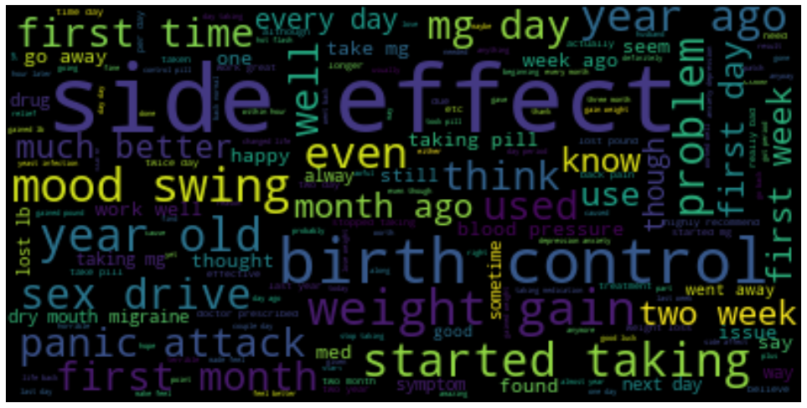
WORD CLOUD FOR REVIEW

Slide 22
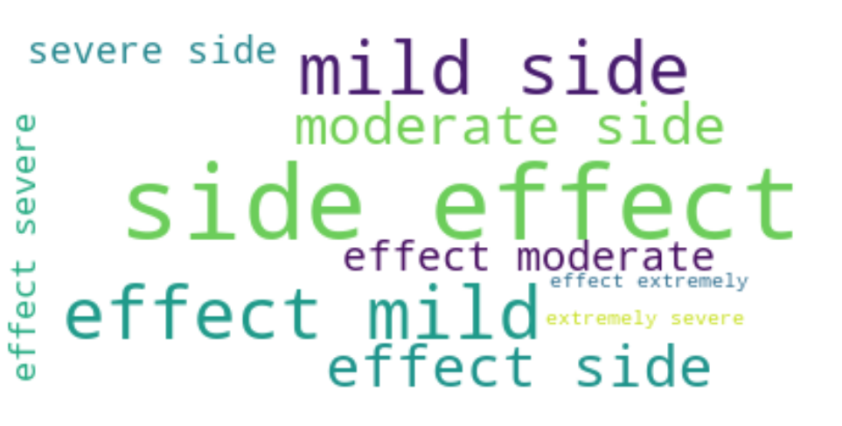
WORD CLOUD FOR SIDE EFFECT

Slide 23
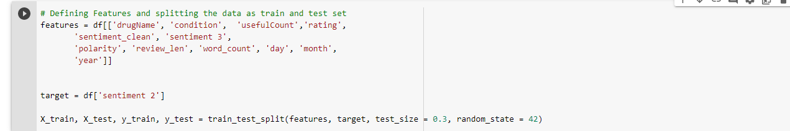
Defining Features and splitting data to Train and Test set

Slide 24
MODEL SELECTION
MODEL 1- LIGHTGBM TRAIN ACCURAY 0.99 TEST ACCURACY 0.86
MODEL 2 – XGBCLASSIFIER TRAIN ACCURACY 0.8027 TEST ACCURACY0.8039
MODEL 3 – NAIYE BAYES TRAIN ACCURACY0.5722 TEST ACCURACY0.5742

Slide 25
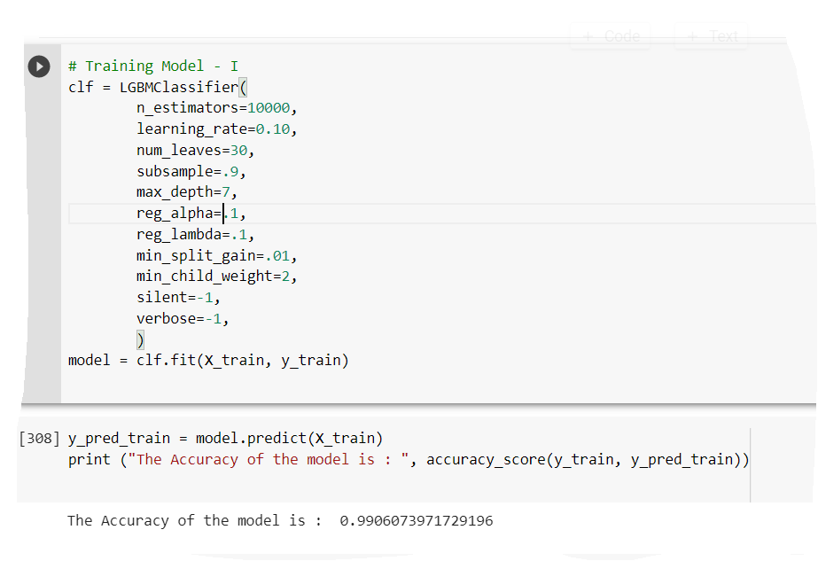
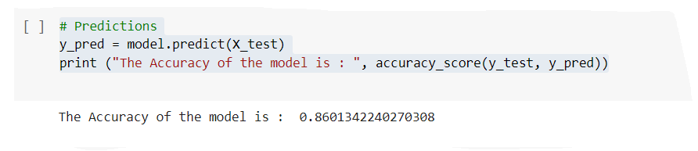
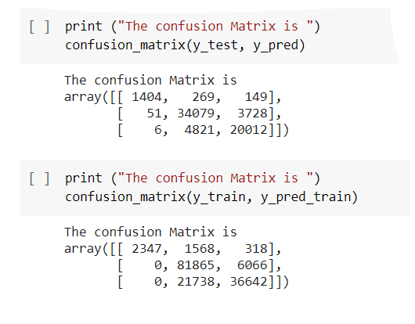
Model I light GBM

Slide 26
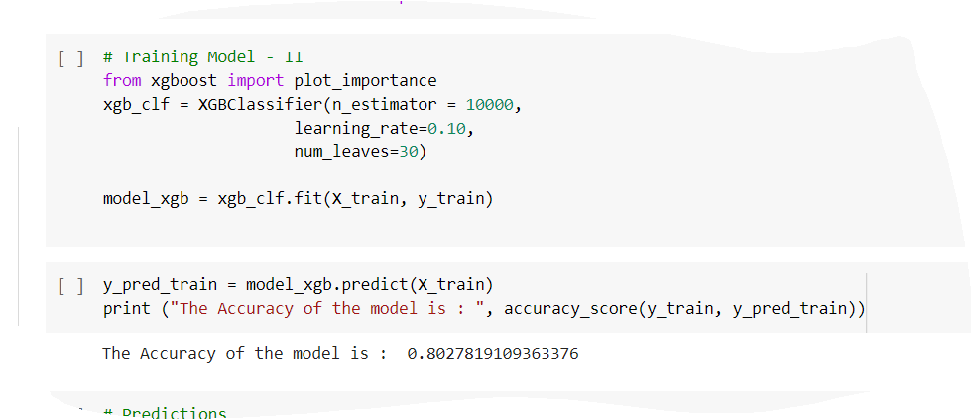
MODEL II XGBCLASSIFIER

Slide 27
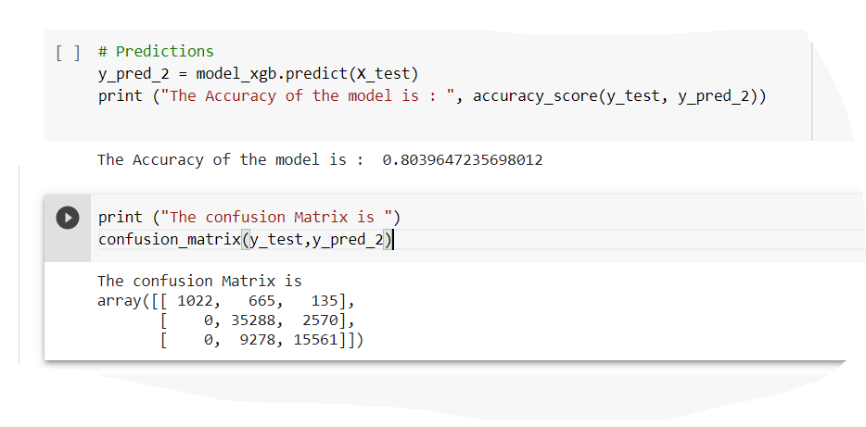
TEST ACCURACY AND CONFUSION MATRIX FOR XGBCLASSIFIER:

Slide 28
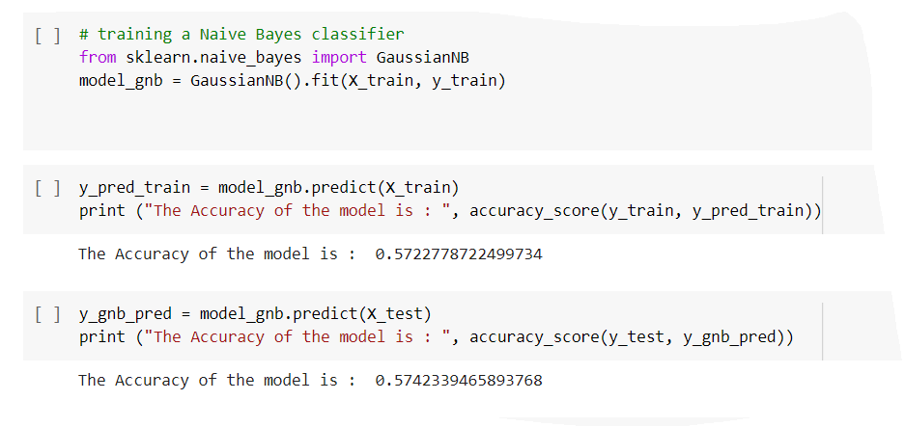
MODEL III – NAÏVE BAYES

Slide 29
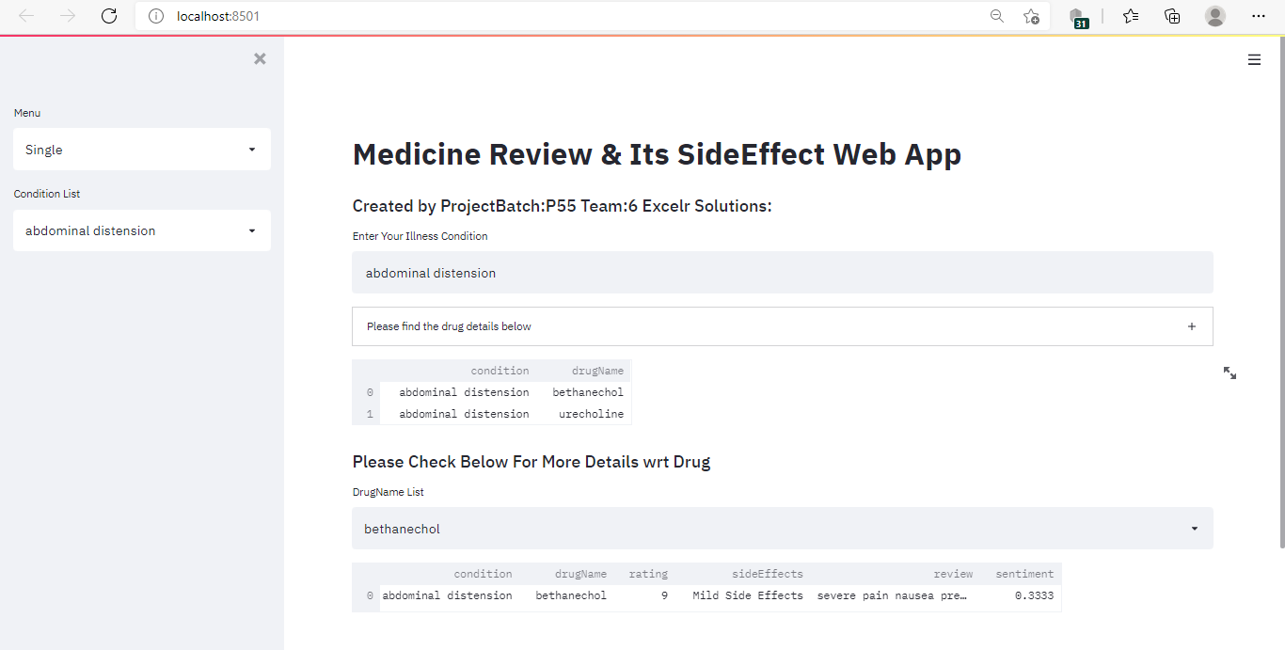
Deployment using Streamlit

Slide 30
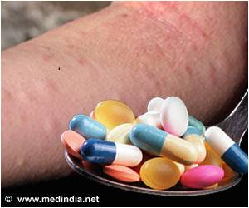
Thank You

